Slide 1
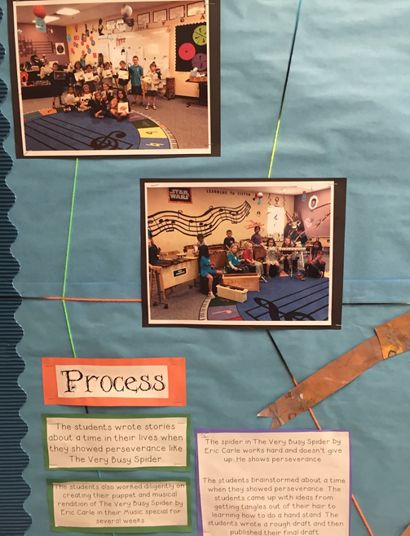
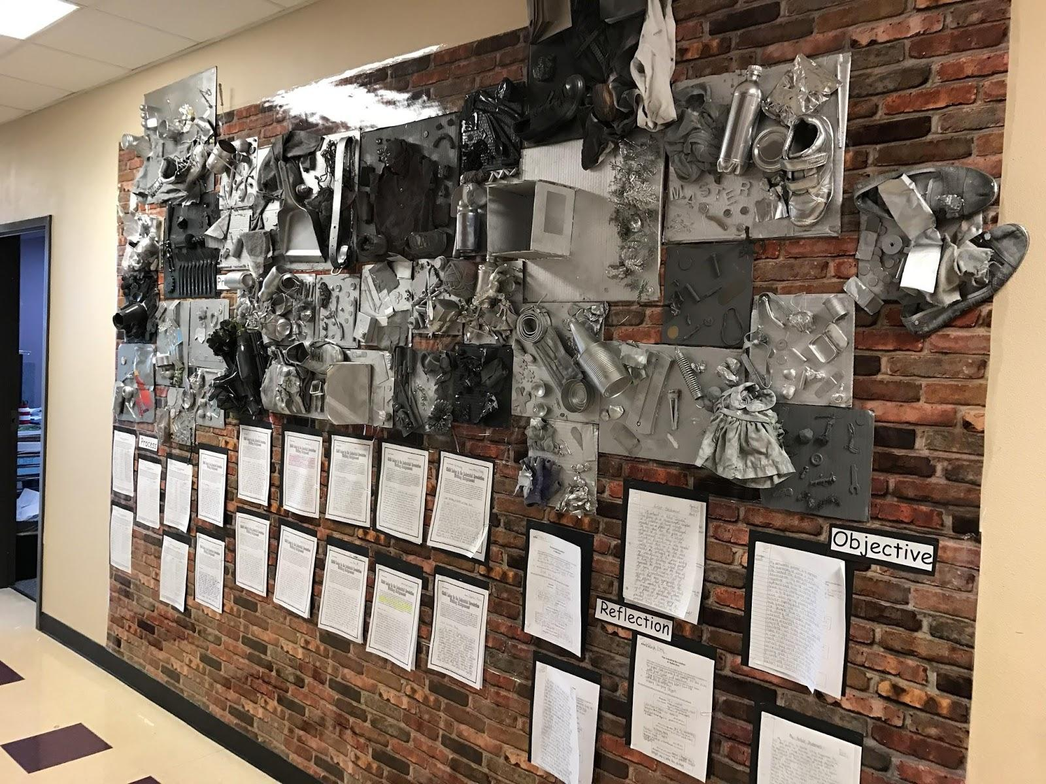
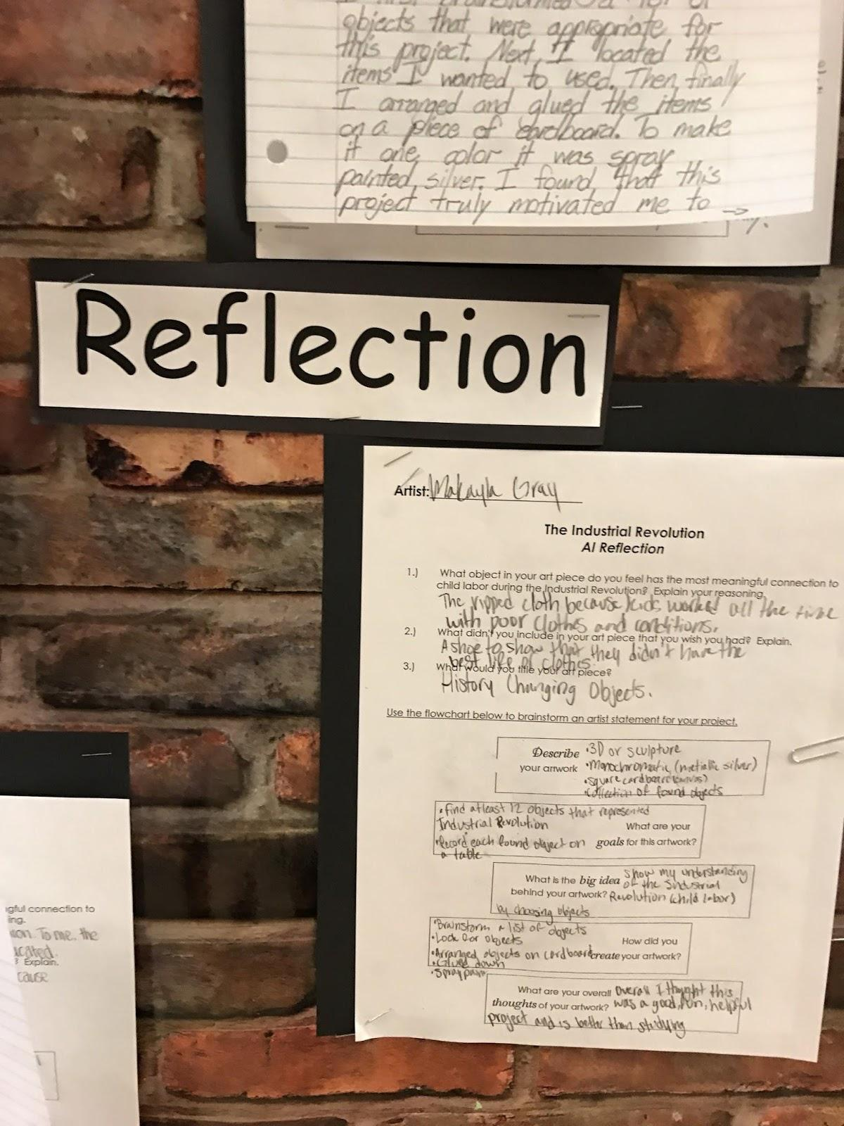
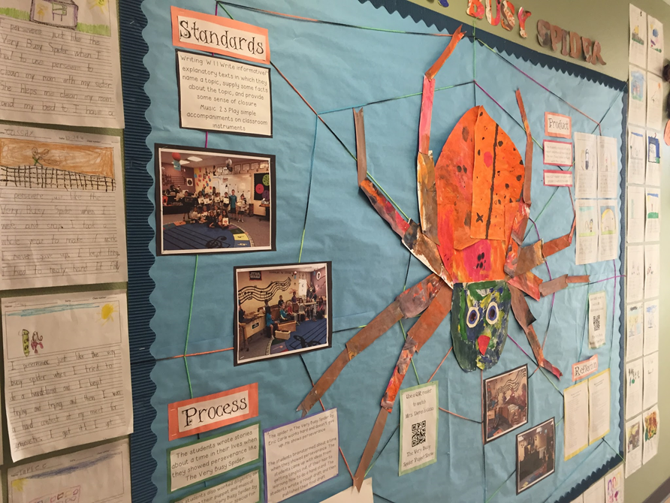
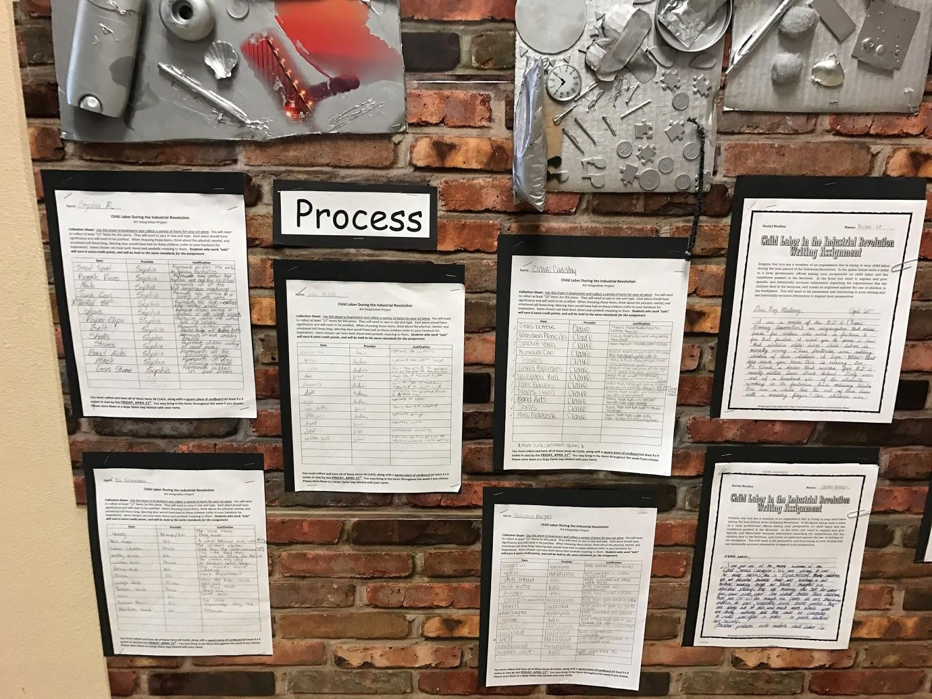
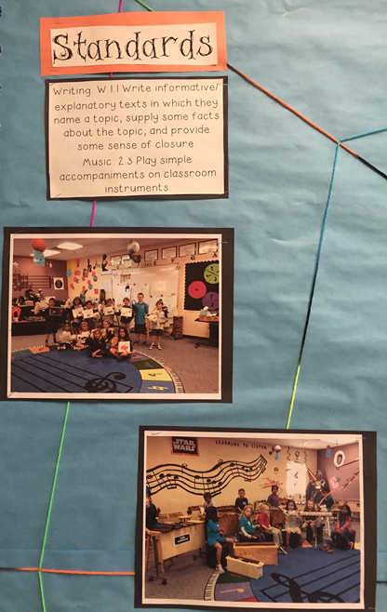
Doral Academy of Nevada:
Academic Engagement - A True Collaborative Process
Notes:
Speaker: Bridget Phillips
-Brief history of Doral Academy of Nevaa
-Key Practice is “Academica Engagement”
-Prior to opening: “Pay for Performance” and evaluation system
-Use of data

Slide 2
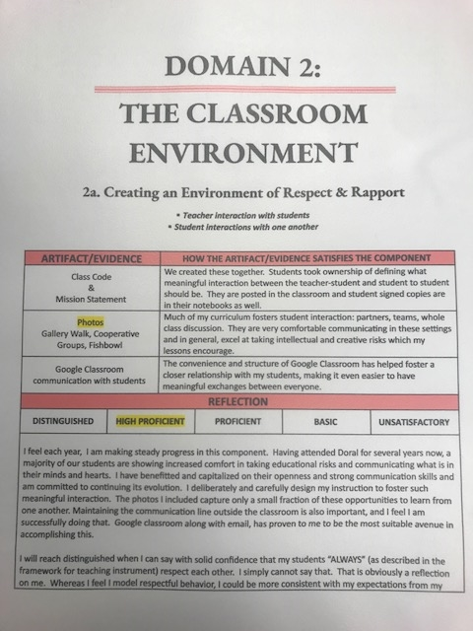
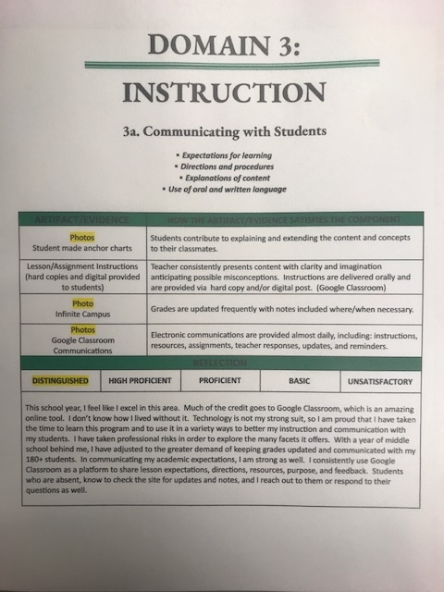
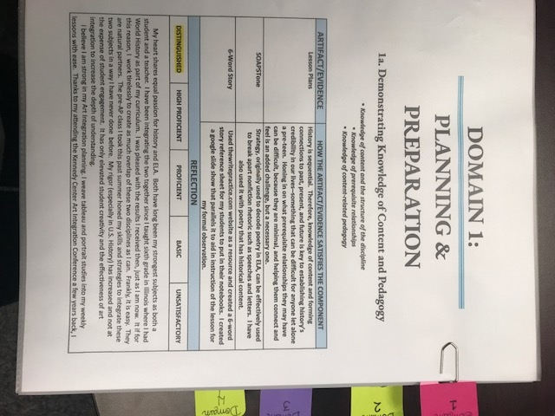
Supervision System
Notes:
Speaker: Danielle Marshall
-Supervision system: very extensive, teacher portfolios, teacher creted specialist achievement rubrics, administrative evaluation, same level of rigor
-All created in a collaborative manner

Slide 3
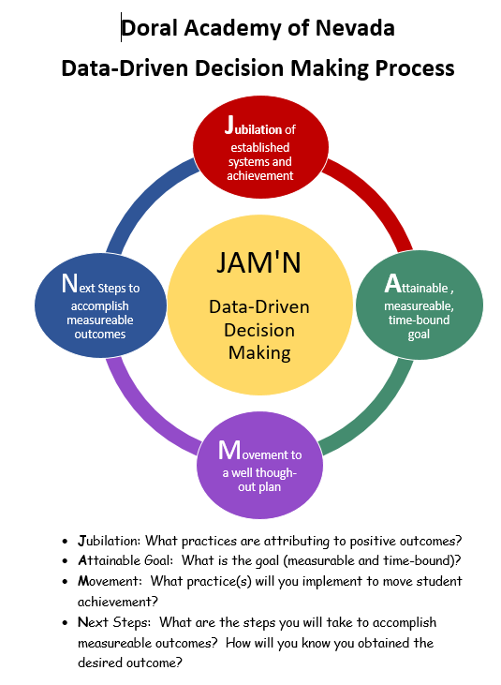
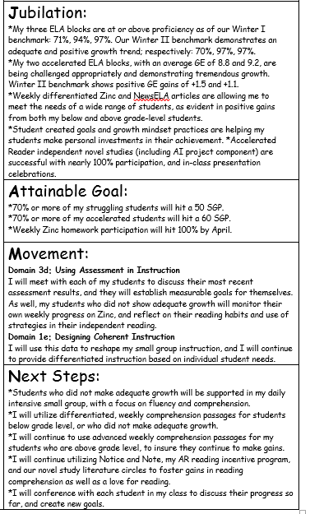
Data Driven Instructional Practices
Notes:
Speaker: Curriculum Coaches
-Use of data to drive instruction
-Data Wall / JAM’N
-Enrichment/Efficacy/RTI
-Student led conferences

Slide 4
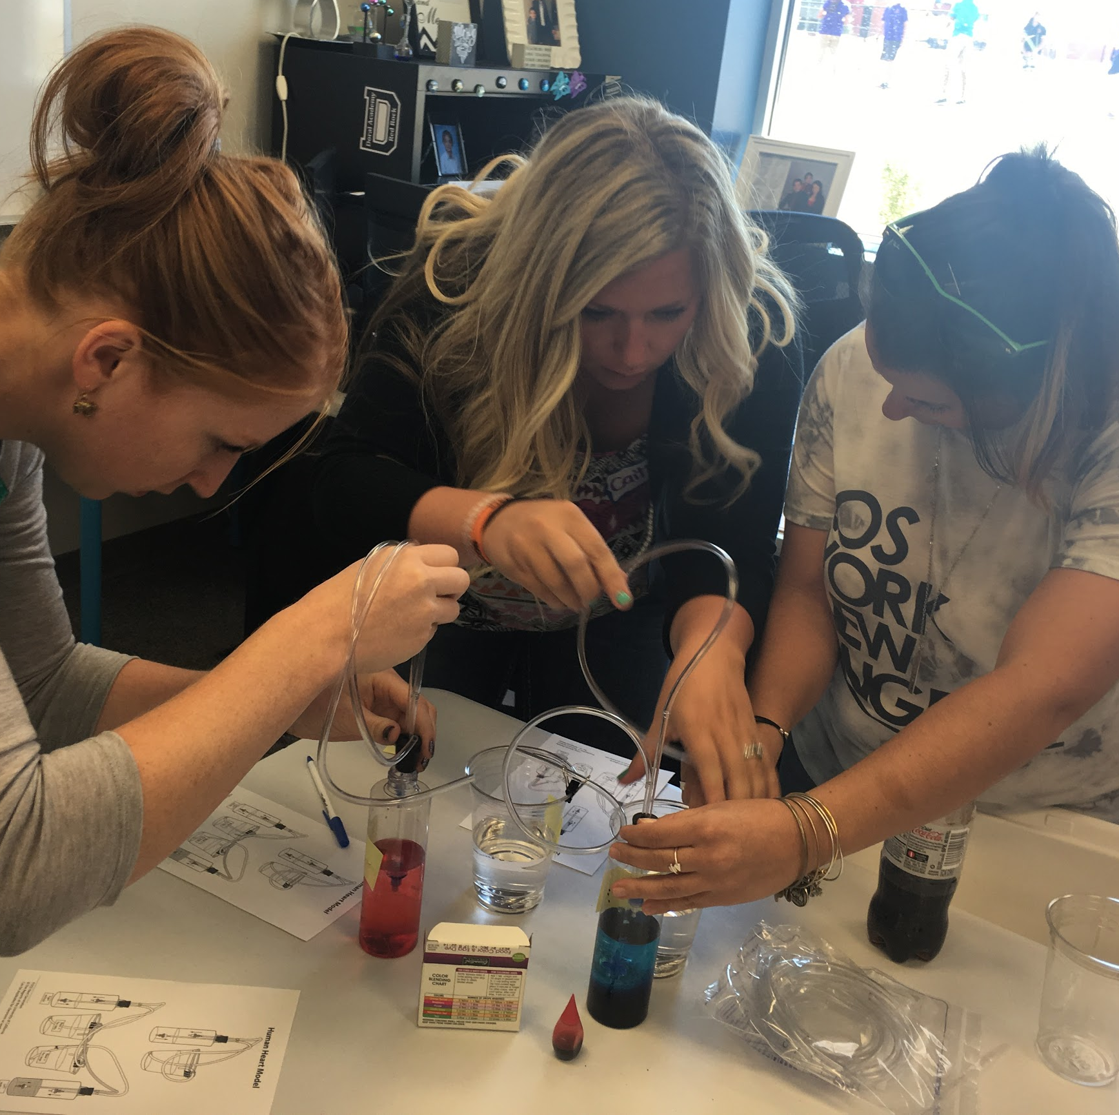
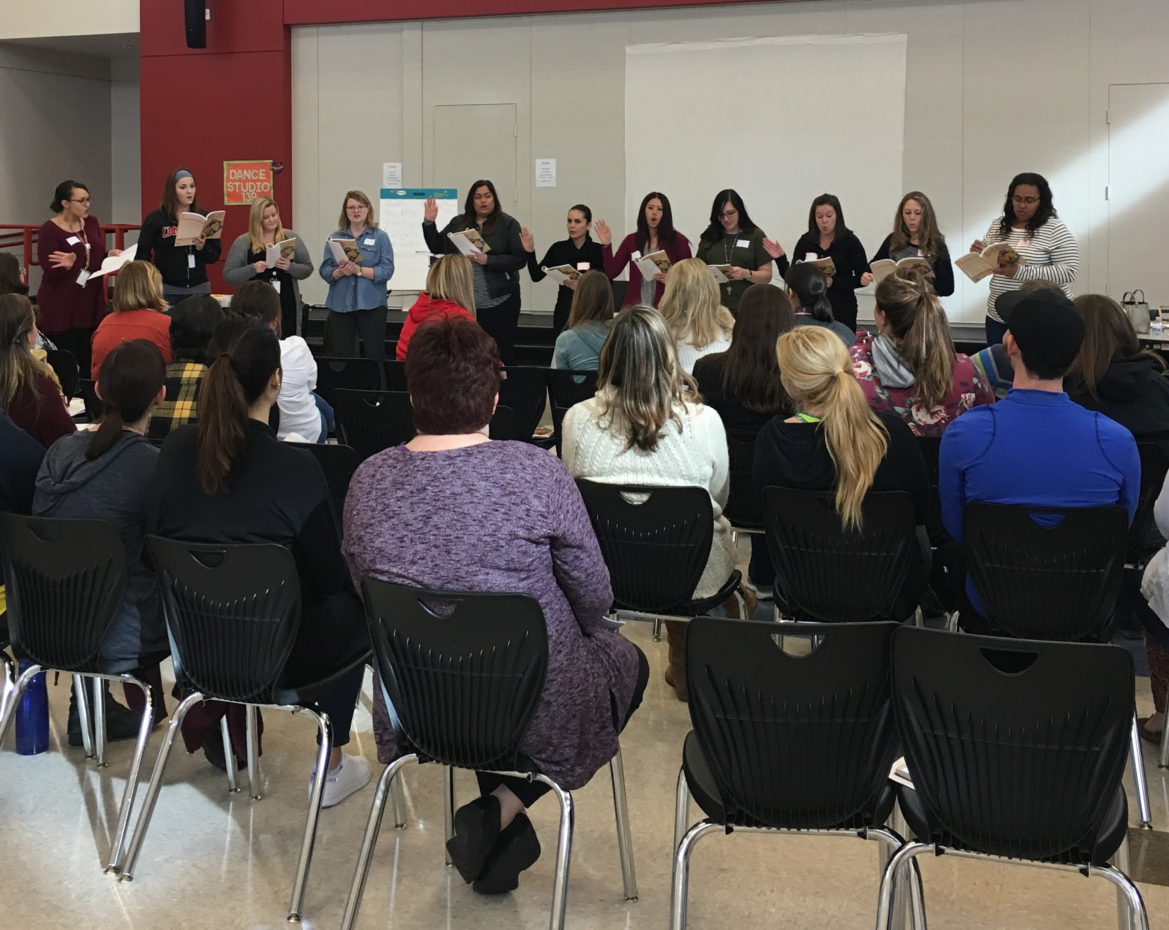
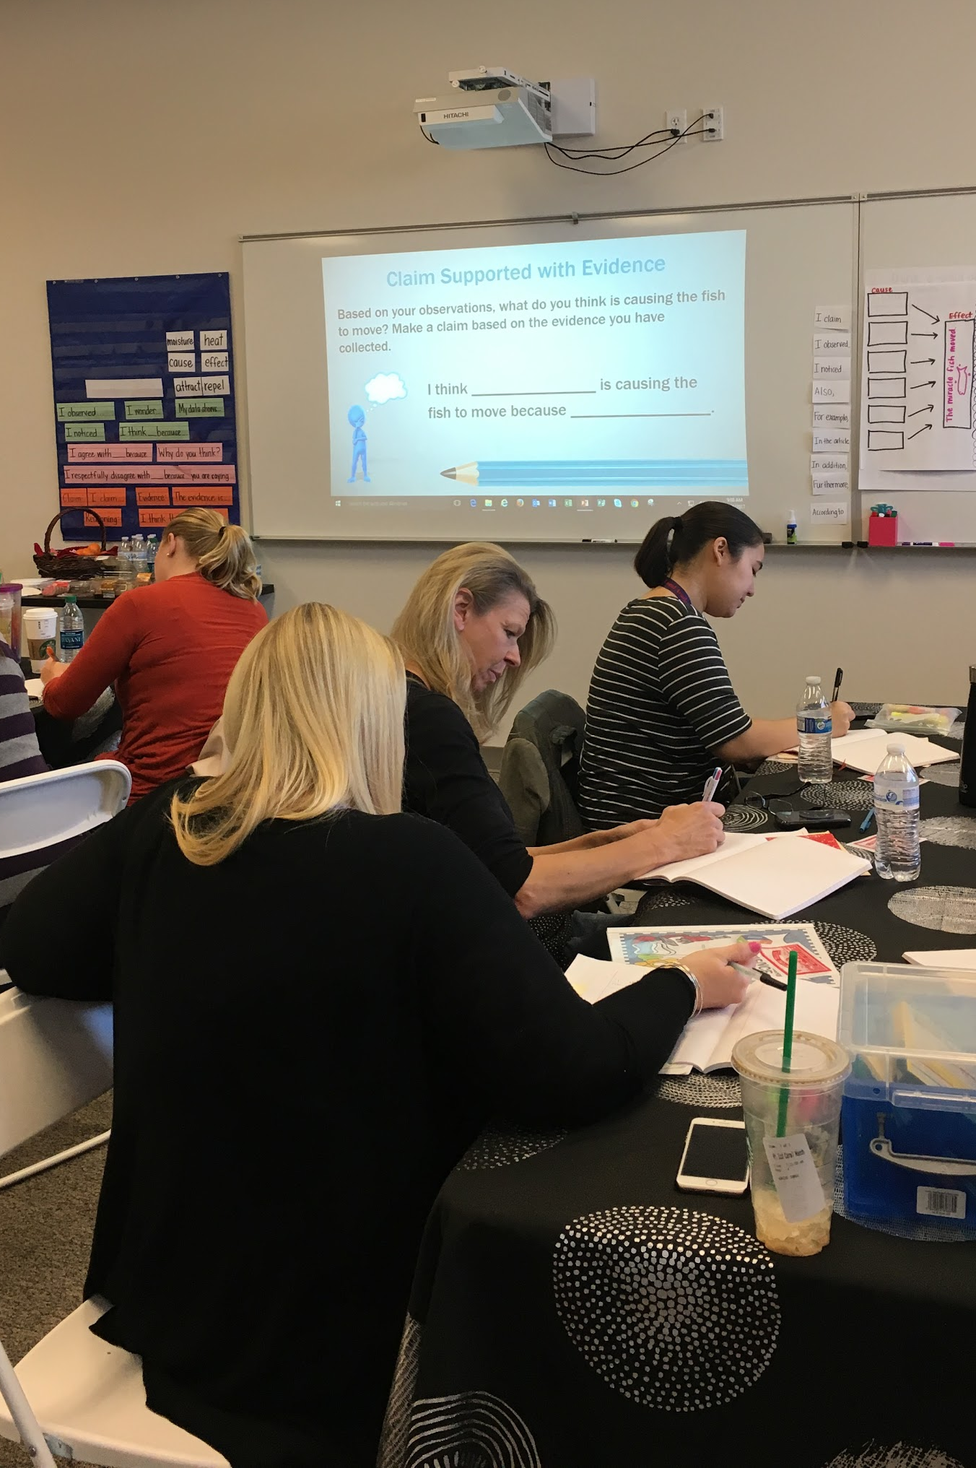
System-Wide Consistency
Notes:
5/14 Speakers: Katrina
5/25 Speakers: Stephanie & Kayla
-Extensive Staff Development
-Regularly scheduled admin/coach meetings / consistent message
-Access to materials
-Grants
-Training (structures : after school work, sub days, weekends, etc.)
-Linkage to SPED - striving for

